Slide 1
CHAPTER 3 Well posed predictive control 2 Short output horizons
Anthony Rossiter

Slide 2
Introduction
This video looks at the impact of changing the output horizon in MPC – we will use a GPC algorithm for convenience.
We start by considering the optimisation from a conceptual point of view, rather than jumping straight into simulation examples.
The word well-posed is used to indicate that an optimisation makes good sense.
Reminder that we are assuming no feed forward information for now.

Slide 3
Short prediction horizon
What is the impact of choosing a low value for the output or prediction horizon?
What is the impact of choosing a very high value for the prediction horizon?
What is a practical choice for the prediction horizon?
Does the presence of constraints affect this understanding?
This video focuses on a choice of nu=1 and small values for ny.

Slide 4
Short output horizons, nu=1
Looks OK within the prediction horizon. (Weighting on input =1)
BUT
Overall prediction strategy is quite poor!
Because the long term predictions are poor, the user will keep changing their mind about what is an ideal input trajectory in order to improve the behaviour.
gpc3_2_example1.m

Slide 5
Short output horizons, nu=1
Reducing the weighting on the input to 0.1 makes little difference.
Overall prediction strategy is quite poor!
THE GPC OPTIMISATION ONLY MINIMISES THE ERRORS WITHIN THE HORIZON AND TAKES NO ACCOUNT OF IMPLIED ERRORS BEYOND THAT POINT.

Slide 6
Open-loop prediction vs closed-loop
The actual closed-loop behaviour is quite different from the open-loop, even within the horizon.
This suggests the optimisation is ill-posed.
Closed-loop behaviour is good more by chance than design.

Slide 7
Short output horizons example 2
Because the long term predictions are poor, the user will keep changing their mind about what is an ideal input trajectory in order to improve the behaviour.
Simple real poles, low input weighting BUT
Overall prediction strategy is quite poor!
gpc3_2_example2.m

Slide 8
Open-loop prediction vs closed-loop
As with example 1, the closed-loop and open-loop trajectories differ significantly.
The closed-loop is stable, but one would surely assume this is due to good luck rather than good design.

Slide 9
Short output horizons example 3
Simple real poles, but one unstable.
Overall prediction strategy is quite poor!
gpc3_2_example3.m

Slide 10
Open-loop prediction vs closed-loop
The actual closed-loop behaviour is quite different from the open-loop, even within the horizon.
The closed-loop is stable, but one would surely assume this is due to good luck rather than good design.

Slide 11
Short output horizons example 4
Because the long term and short term predictions are poor, the user will keep changing their mind about what is an ideal input trajectory in order to improve the behaviour.
Complex poles, but stable.
Overall prediction strategy is quite poor!
gpc3_2_example4.m

Slide 12
Illustration of poor behaviour
Using prediction and optimisation alone is not enough to imply that the ‘optimised’ input trajectory is a good one.
The optimised input trajectory could be a very poor choice indeed.
THIS IMPLIES THAT THE OPTIMISATION IS NOT WELL-POSED
Either the performance index is poorly chosen and/or the degrees of freedom are poorly chosen as neither results in an effective control strategy.

Slide 13
Rationale
The performance index only penalises tracking errors over ny samples, with no regard to the implied tracking beyond that.
Imagine driving a car where you optimised behaviour over the next 2 seconds, with no consideration of what lies beyond.
You would not see corners 50yds ahead and thus make no allowance to ensure you could get around them.
Overtaking would be fun! Whoops, didn’t anticipate the oncoming traffic, or a traffic island, or … !
Any control strategies are seriously flawed because they do not allow for the whole picture!

Slide 14
Daft example on firewood
You are cold and want the fire to give off more heat quickly.
So you pile on (carefully to avoid killing existing flames) lots of wood.
In short term, parts of all the new wood catch alight and the fire is lovely.
Unfortunately, 5 minutes later, much more of the new wood has caught alight and now you have raging bonfire - a little too hot and dangerous.
Your decision making only considered the short term future and not the long term and thus was flawed.
What other examples can you think off?
Behaviour of children (failure to think through consequences).
Write an angry email and post immediately, or wait overnight and read again?
Etc.

Slide 15
SUMMARY OF LOW NY
THERE IS NO PENALTY ON TRACKING ERRORS BEYOND THE PREDICTION HORIZON
THE IMPLIED TRACKING ERRORS COULD BE VERY LARGE AND YET HAVE NO IMPACT ON THE DECISION MAKING (OPTIMISATION).
WE END UP REPEATEDLY CHANGING OUR MIND ON WHAT IS A GOOD TRAJECTORY.
CLEARLY, LOW PREDICTION HORIZONS ARE NONSENSE, YOU SIMPLY CANNOT (OR SHOULD NOT) DO IT!
How big should the output horizon be?

Slide 16
Conclusions
Demonstrated through numerous examples that for many cases, a low output horizon almost always leads to very poor predictions.
OPTIMISED PREDICTIONS DO NOT GIVE A GOOD MATCH TO TARGET OVER A LONGER HORIZON.
Does not deal well with non-minimum phase characteristics, unstable open-loop behaviour or oscillatory open-loop poles.
The use of associated performance index can be misleading as it may not imply optimality in any reasonable sense.
You cannot use a small output horizon and expect the performance index to be meaningful.

Slide 17



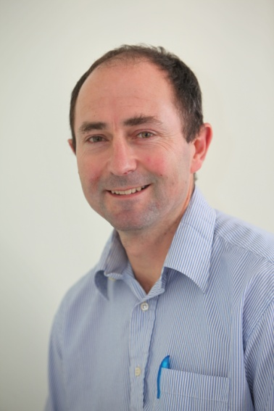
Anthony Rossiter
Department of Automatic Control and Systems Engineering
University of Sheffield
www.shef.ac.uk/acse
© 2014 University of Sheffield
This work is licensed under the Creative Commons Attribution 2.0 UK: England & Wales Licence. To view a copy of this licence, visit http://creativecommons.org/licenses/by/2.0/uk/ or send a letter to: Creative Commons, 171 Second Street, Suite 300, San Francisco, California 94105, USA.
It should be noted that some of the materials contained within this resource are subject to third party rights and any copyright notices must remain with these materials in the event of reuse or repurposing.
If there are third party images within the resource please do not remove or alter any of the copyright notices or website details shown below the image.
(Please list details of the third party rights contained within this work.
If you include your institutions logo on the cover please include reference to the fact that it is a trade mark and all copyright in that image is reserved.)

